Slide 1
RaMP 2016
Melissa MacDonald
Mentor: Mariana Stevens
PI: Aaron Zorn
Developmental Biology

Slide 2
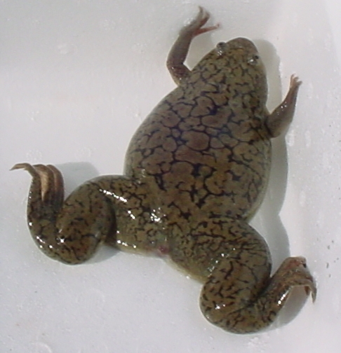
What?
Xenopus laevis
In situ = “in place”
Expression → Regulation
Pathways
Injection
Transgenic animals (heat shock)
Small molecules
Notes:
Transgenic: Changed something on genome, heat activates. Heat shock promoter
Small molecules: dmh1: bmp inhibitor BIO: wnt inducer

Slide 3
In situ protocol
mRNA
A
A
Probe
C
Anti-DIG
G
C
Staining
C
U
G
A
DIG
A
G
U
A
C
U
G
Notes:
Add DIG to circle
Substrate reacts with enzyme to be purple
Probes are actually 18-25 bp

Slide 4
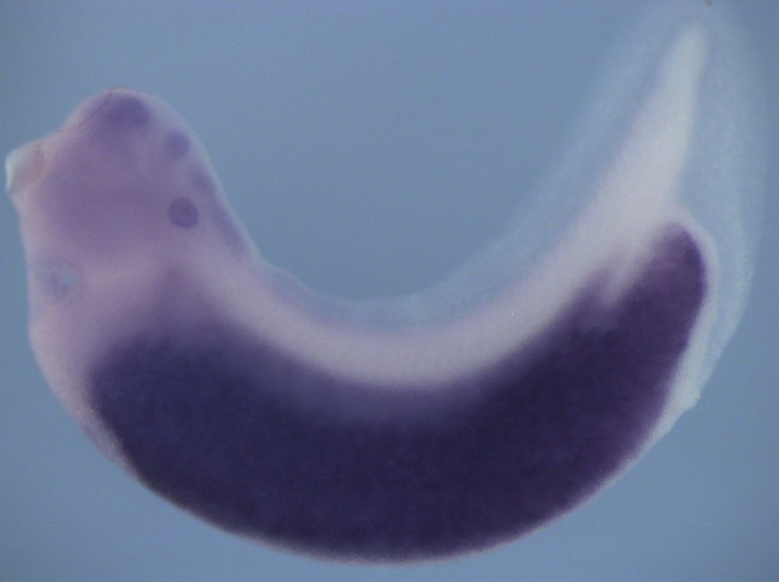
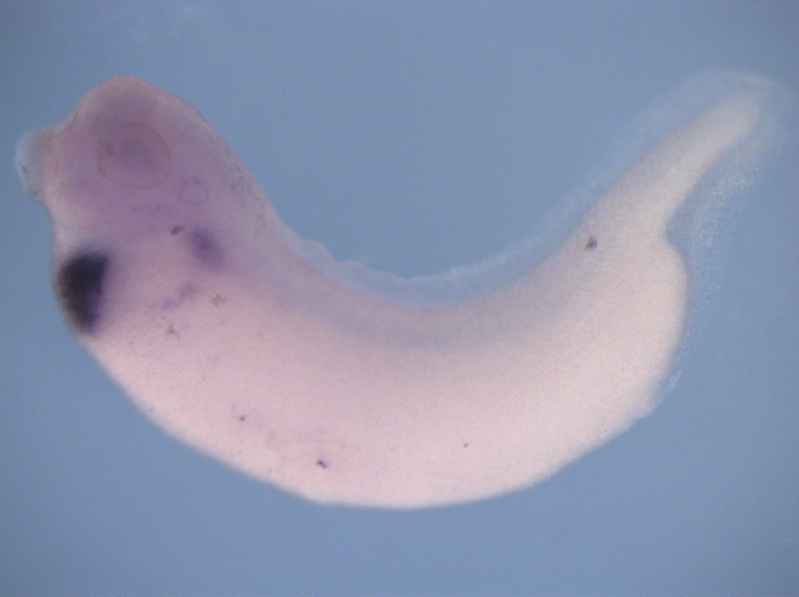
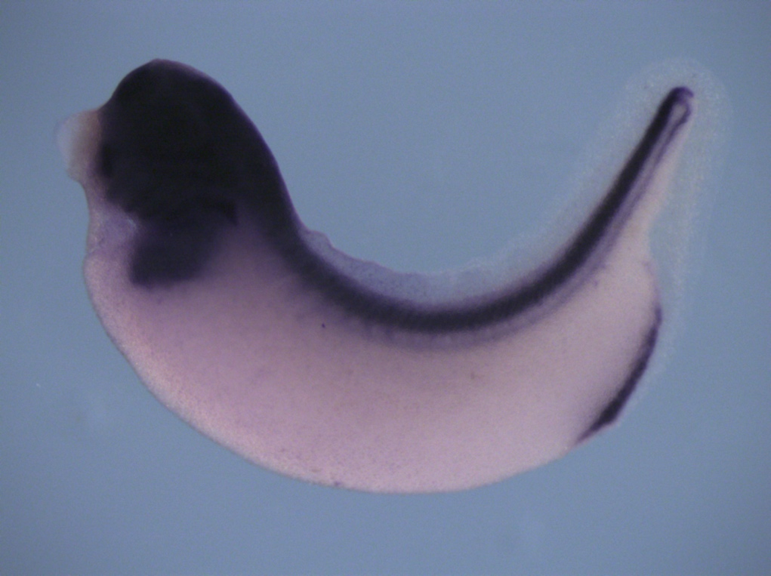
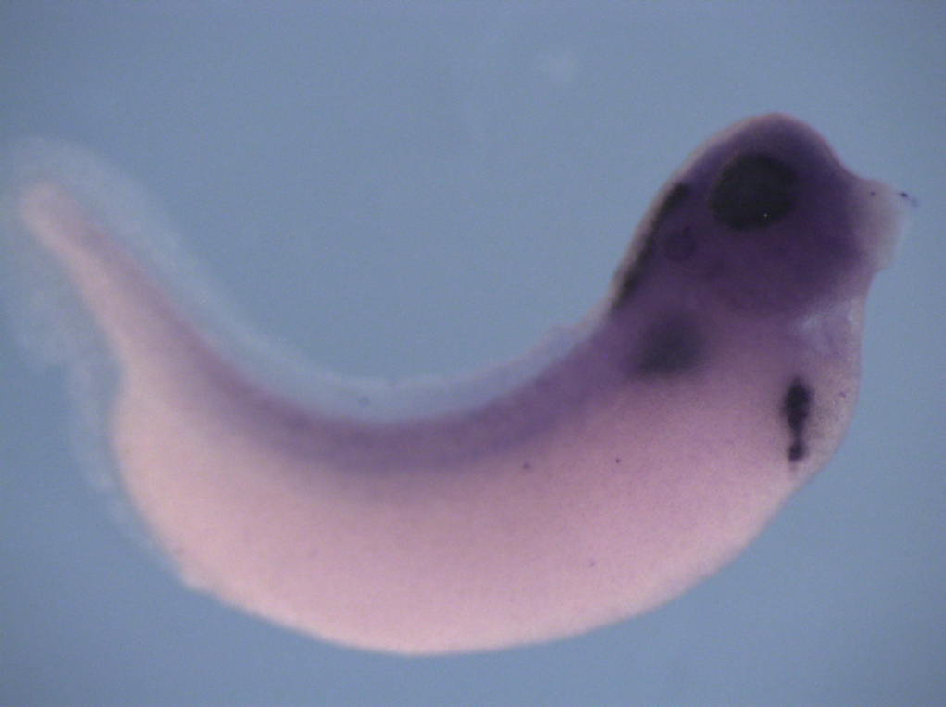
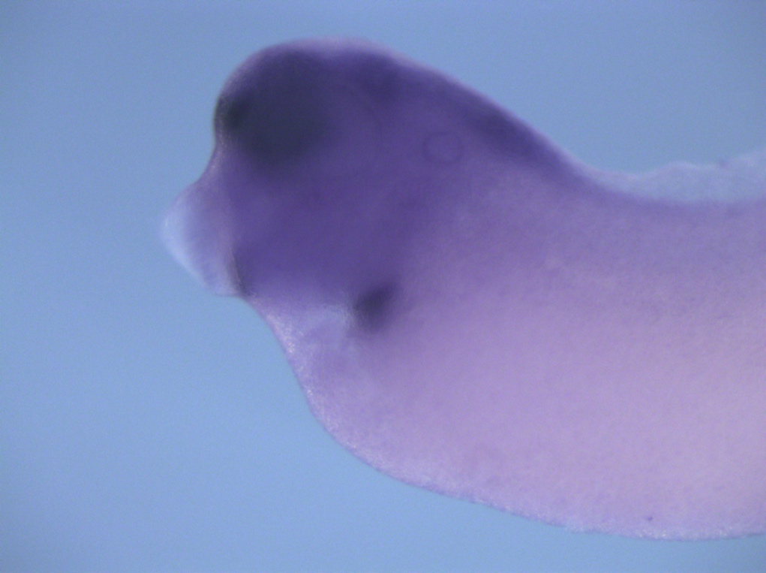
In situ staining shows gut organs
Intestine
Liver
Stomach
darmin
for1
sox2
Pancreas
Lungs
ptf1a
nkx2

Slide 5
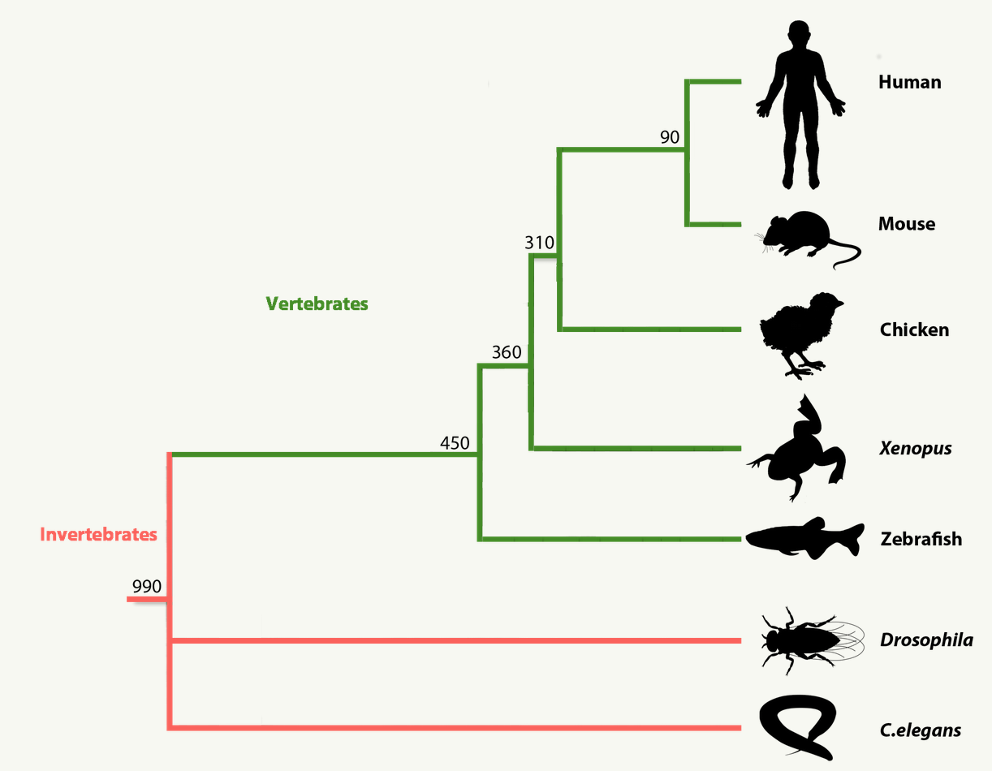
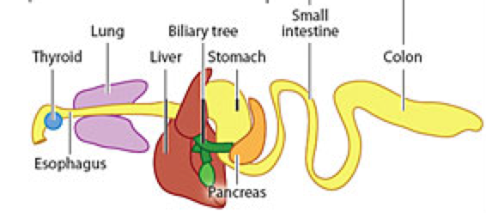
So What?
Frog- Conservation of genes across species (BMP, Wnt)
Understand how the gut tube is patterned
Notes:
Add animation with bottom of dr zorns figure

Slide 6
Now What?
Women in Science and Engineering Research Experience for Women Undergraduates
Summer project: in situ and PCR for novel genes in the Xenopus genomes
Notes:
In situ and pcr for novel genes from rna seq(Mariana’s study)

Slide 7
References
www.Xenbase.org

